Slide 1


Car Price Predictor
👩‍💻👩‍💻👩‍💻👩‍💻 Fit4AI ☺
🅺 Kaggle Data Set Source
Try our app on Hugging Space
GitHub Link of Our Project

Slide 2
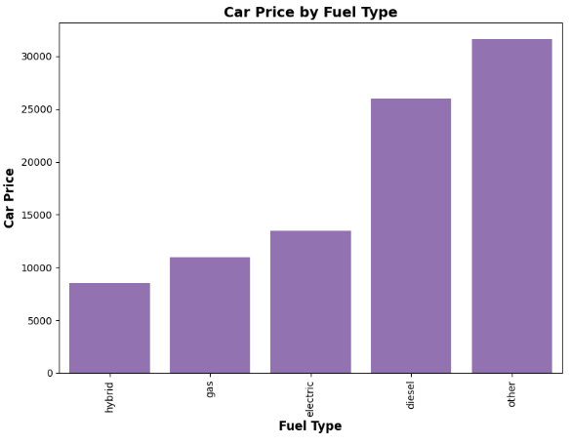
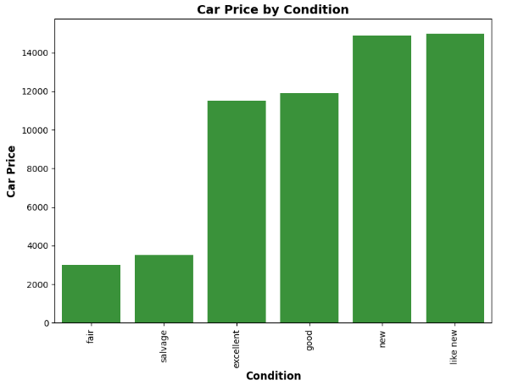
Project Overview & Insights
🔍 Real-world Problem: Estimating used car prices is complex due to varied vehicle conditions, market trends, and user bias.
📥 Data Sourced from Craigslist: Used a public dataset featuring car attributes like year, mileage, brand, condition, and more.
💻 Tech Stack: Built using Python, Pandas, Scikit-learn, Streamlit; deployed on Hugging Face Spaces.
📈Key Insights: Features like car age, year, mileage, condition, and fuel type were highly influential.
Notes:
This project tackles the intricate challenge of predicting used car prices, which can vary significantly due to condition, mileage, brand perception, and other subjective factors. We addressed this by leveraging a structured dataset sourced from Craigslist listings. The dataset was carefully cleaned and curated, capturing essential variables like car year, odometer reading, fuel type, and condition.
We chose a robust tech stack: Pandas for data processing, Scikit-learn for building machine learning pipelines, and Streamlit for crafting an interactive web interface. The app was made publicly accessible through Hugging Face Spaces, enabling real-time predictions.
This blend of practical data science and user-centered design lays the foundation for a scalable AI solution in automotive price estimation.

Slide 3
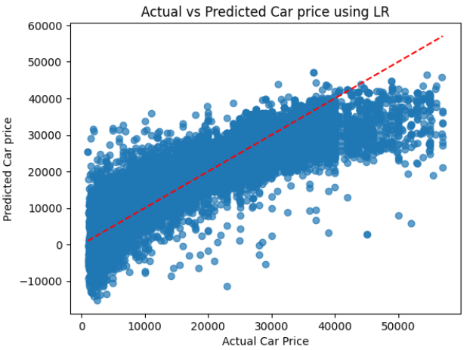
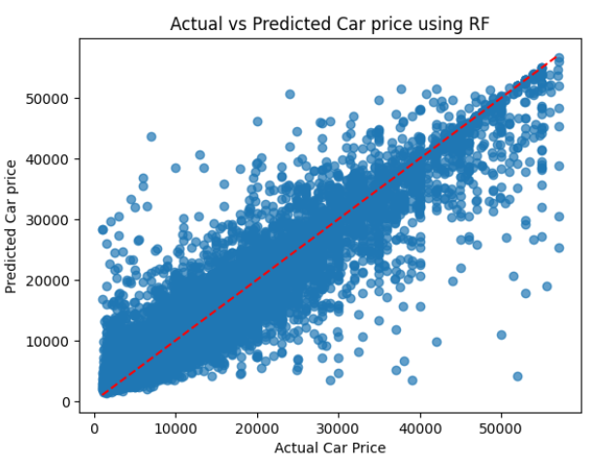
Modeling & Evaluation
📊 Models Implemented:
Implemented Linear Regression and Random Forest Regressor to predict car prices.
📈 Performance:
Model R² Score RMSE
------------------ ---------- ------
Linear Regression 0.73 6130
Random Forest 0.88 4234 ✅
Notes:
In our modeling phase, we developed two predictive algorithms: a baseline Linear Regression and a more advanced Random Forest Regressor. Each model was trained on the cleaned dataset to forecast used car prices based on multiple vehicle features.
The Random Forest model significantly outperformed Linear Regression, achieving an R² score of 0.88 and an RMSE of approximately 4234, compared to 0.73 and 6130 for Linear Regression. This improvement was primarily due to Random Forest’s ability to capture non-linear relationships and interactions among features.
Exploratory Data Analysis revealed that car age, mileage, condition, and the number of cylinders played a key role in price prediction. These insights not only informed the model but also provide transparency into factors influencing pricing decisions.

Slide 4
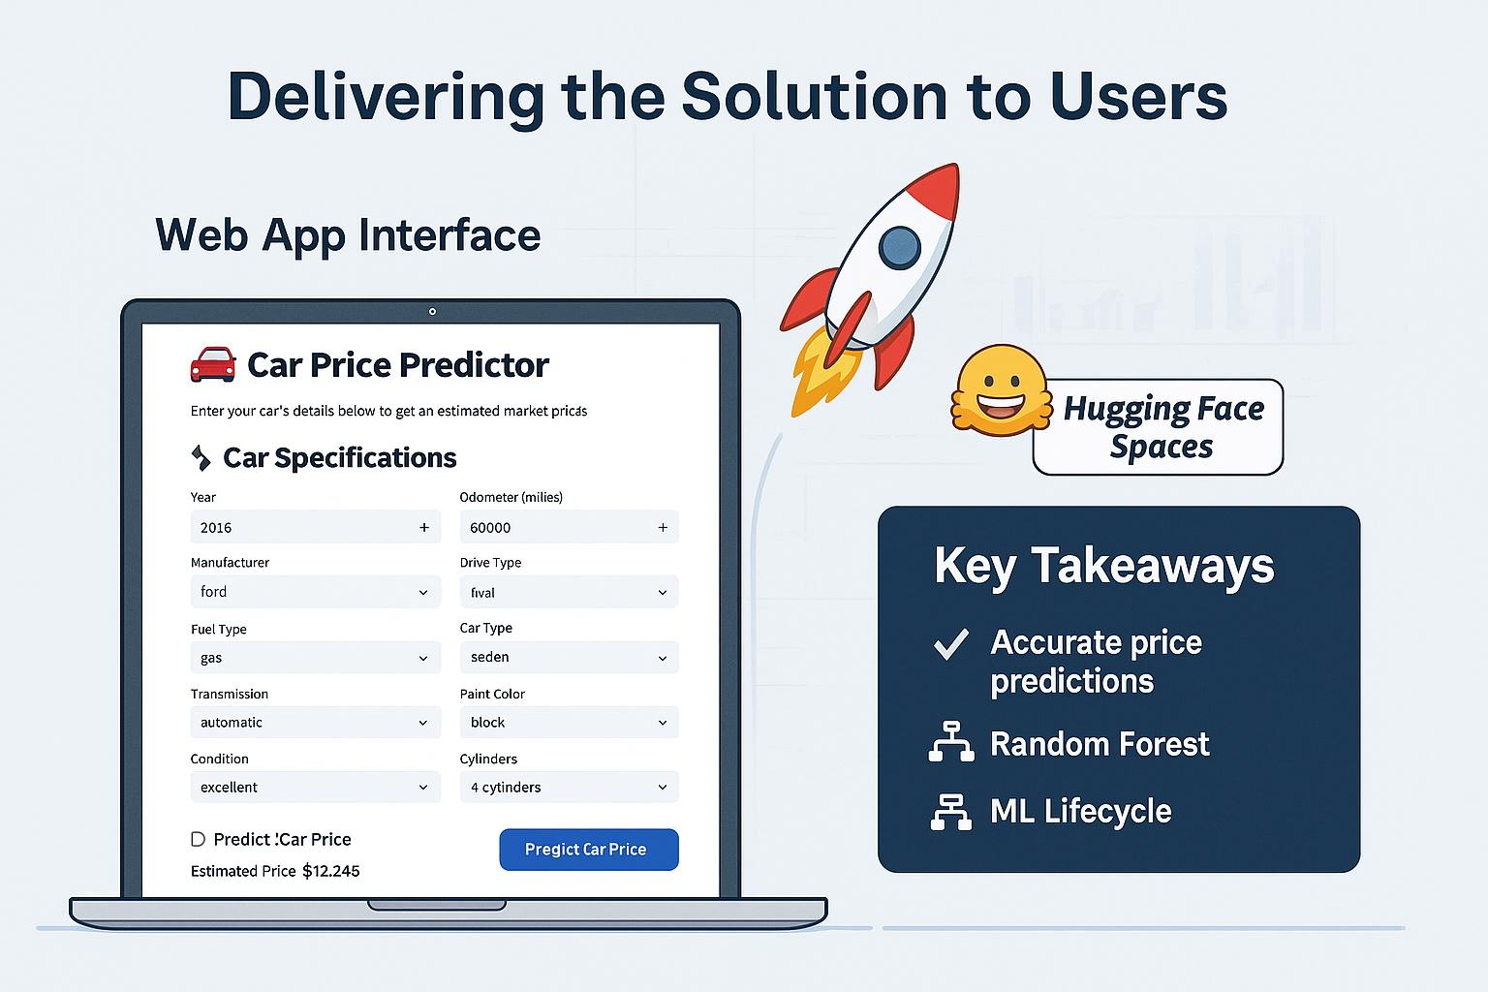
Deployment & Conclusion
Delivering the Solution to Users
🖥️ Web App Interface: Built an interactive UI using Streamlit with real-time predictions for user inputs.
🚀 Public Deployment: Deployed the app on Hugging Face Spaces for global access without installation.
🏁 Key Takeaways: Accurate price predictions with Random Forest; project highlights full ML lifecycle.
Notes:
To make the model accessible to end users, we built a sleek Streamlit-based web app. The interface allows users to enter vehicle details like year, mileage, and condition to get instant price predictions. Custom CSS was applied for a cleaner and more intuitive experience.
We deployed the app to Hugging Face Spaces, making it publicly available with no need for downloads or setup. This ensures usability for non-technical audiences and stakeholders.
Overall, this project demonstrates the full machine learning pipeline—from data ingestion and preprocessing, through model training and evaluation, to deployment and user engagement. It’s a complete AI-powered solution to a practical pricing problem.

